Slide 1
Analysis and Design
Analysis:
Analysis emphasizes an investigation of the problem and requirements, rather than solution. For example, if a new online trading system is desired, how will it be used? What are its functions?
During object oriented analysis there is an emphasis on finding and describing the objects
For example in case of flight information system, some of the concept include Plane, Flight and Pilot.

Slide 2
Design
Design emphasis on a conceptual solution in software that fulfills the requirement, rather than its implementation.
During object oriented design there is an emphasis on defining software objects and how they collaborate to fulfill the requirements
For example, a plane software may have a tailNumber attribute and a getFlightHistory method.

Slide 3
Data Design
Structured Approach – ER diagram
Object Oriented Approach – Class Diagram

Slide 4
Cardinality and Modality in ER diagram

Slide 5
Cardinality
One-to-one (l:l)— a student can have only one Roll number
• One-to-many (l:N)— a mother can have many children, but a child can have only one mother.
Many-to-many (M:N)— an uncle can have many nephews, while a nephew can have many uncles
Cardinality defines “the maximum number of objects that can participate in a relationship”.
It does not, however, provide an indication of whether or not a particular data object must participate in the relationship.
To specify this information, the data model adds modality to the object/relationship pair.

Slide 6
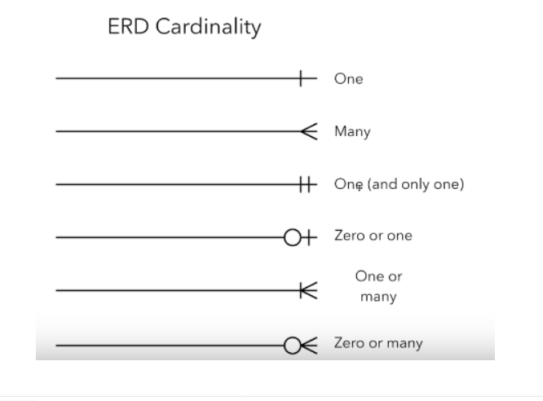
Cardinality and Modality

Slide 7
Modality
The modality of a relationship is 0 if there is no explicit need for the relationship to occur or the relationship is optional.
The modality is 1 if an occurrence of the relationship is mandatory.
Example : A customer indicates that there is a problem. If the problem is diagnosed as relatively simple, a single repair action occurs. However, if the problem is complex, multiple repair actions may be required

Slide 8
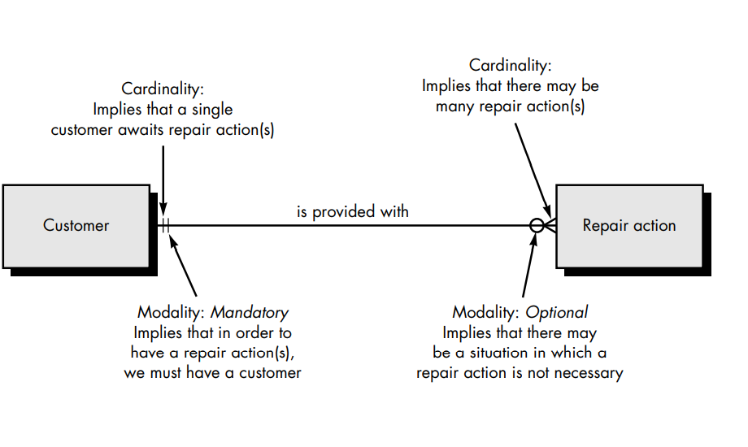
Modality

Slide 9
Class Diagram
Check lab sheet
Don’t forget to use multiplicity in class diagram
Also learn about different symbols used in class diagram

